Slide 1
Generative Art
As an intelligent system

Slide 2
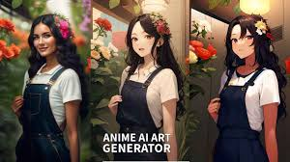
Generative art refers to art that in whole or in part has been created with the use of an autonomous system. An autonomous system in this context is generally one that is non-human and can independently determine features of an artwork that would otherwise require decisions made directly by the artist

Slide 3
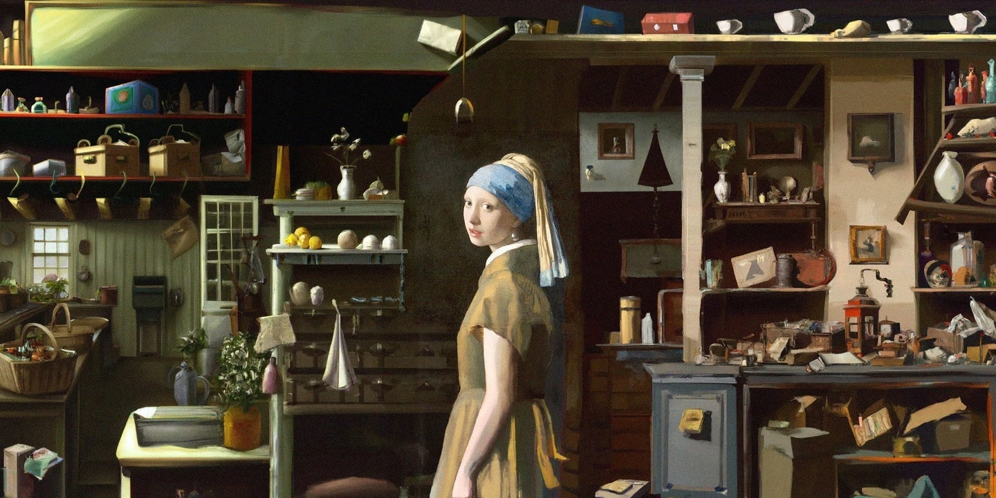
Intelligent behaviors
- Generates art that satisfies requirements given by user
- Automatically add context that is otherwise unspecified
- Draws like a professional artist
Unintelligent behaviors
- Some art generation are error-prone and may not make sense
- Rely on samples from other artist’s work, Risk of copyright

Slide 4
Imagination of the workings of generative AI
1. If require user input, use NLP to understand user requirements and expectations.
2. Retrieve art samples from knowledge base that matches user specifications
3. If there are no user specifications and unknown content should be added, analyze image content, make sense of the image theme, and add content ideas after retrieving items that matches the same image theme.
4. Proceed to produce art based on retrieved knowledge from knowledge base.

